Slide 1


A search for flavour changing neutral currents involving a top quark and a Z boson
using the data collected by CMS at a
centre-of-mass energy of 13 TeV
Isis Van Parijs
VUB – IIHE
26 Januari 2018
Promotor Prof. J. D’Hondt

Slide 2
Een zoektocht naar smaakveranderende neutrale stromen gerelateerd met een top quark en een Z boson
gebruik makend van de data gecollecteerd door het CMS experiment met een massamiddelpuntsenergie van 13 TeV
Isis Van Parijs
VUB – IIHE
26 Januari 2018
Promotor Prof. J. D’Hondt

Slide 3


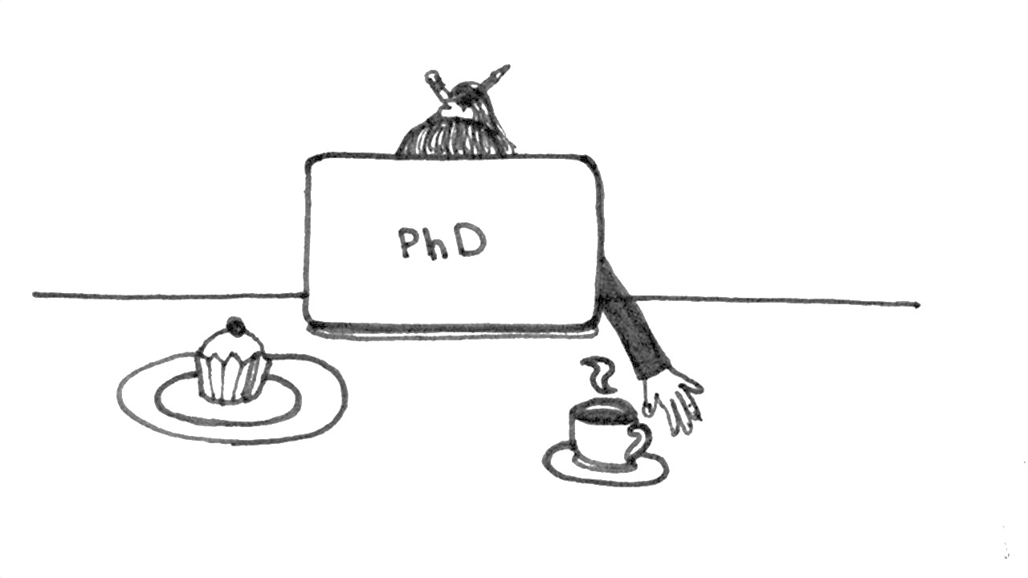
What have I been doing

Slide 4


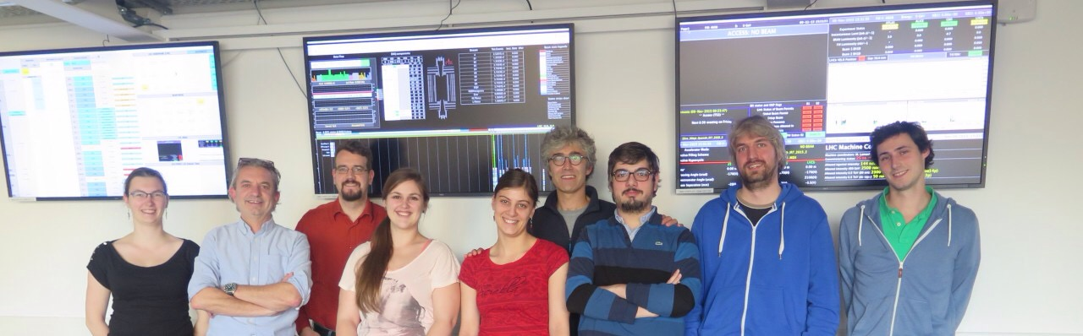
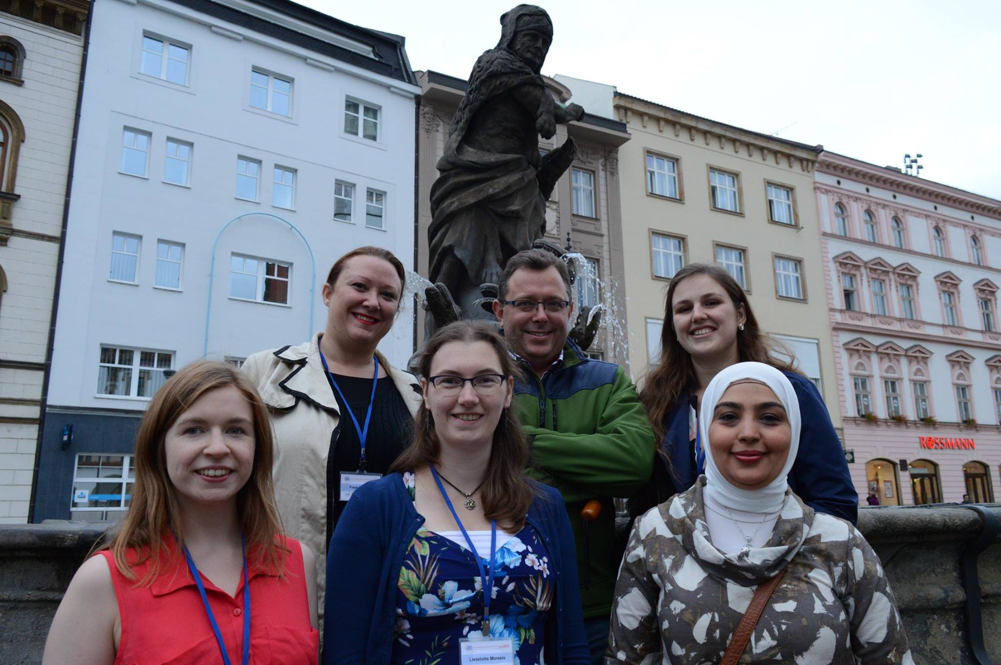

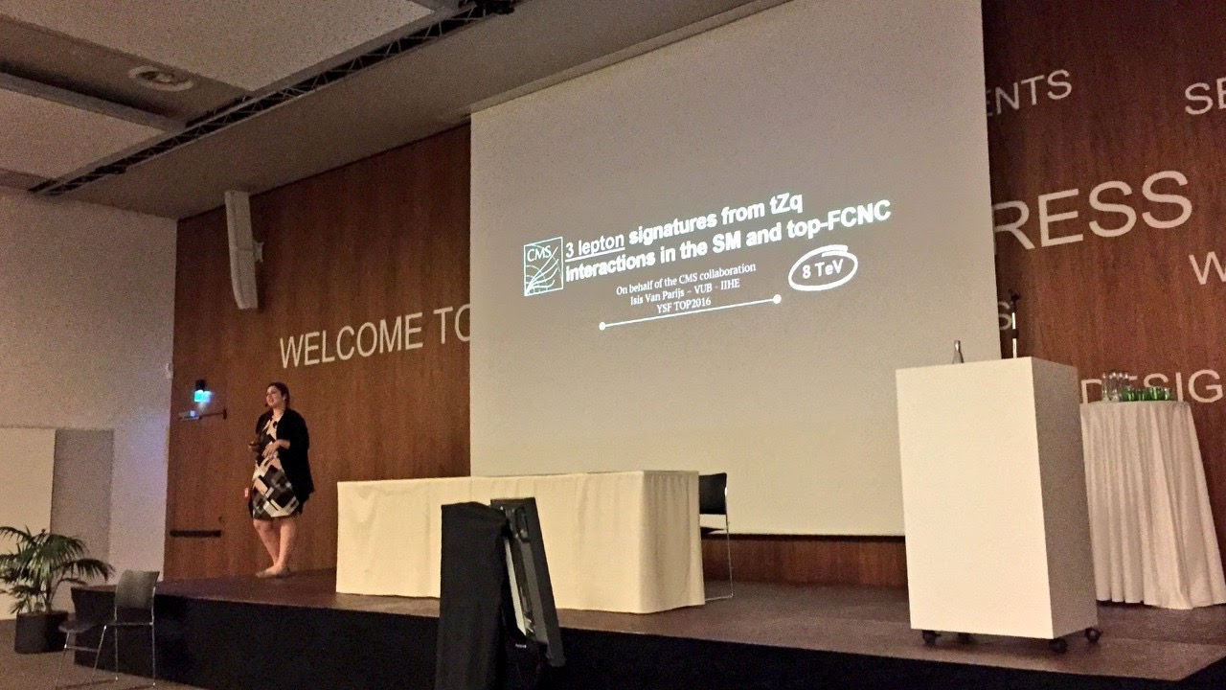


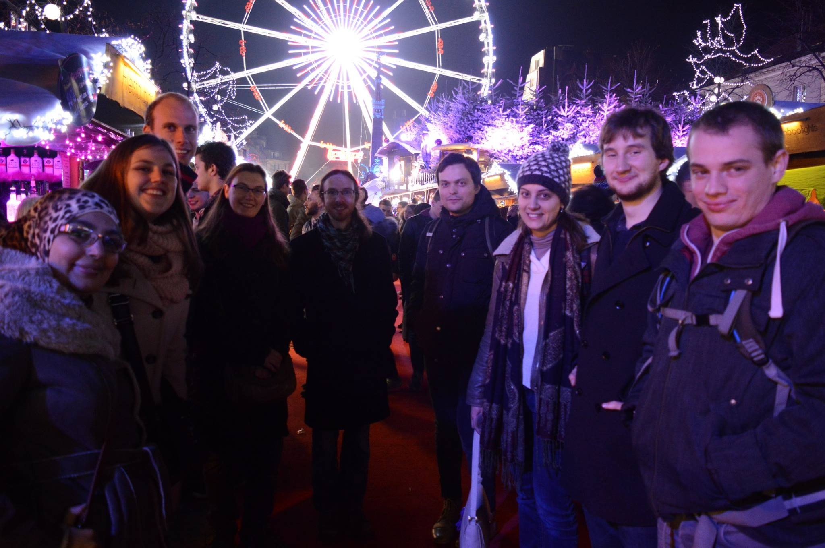
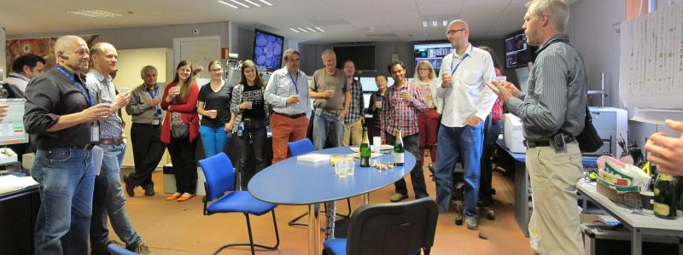
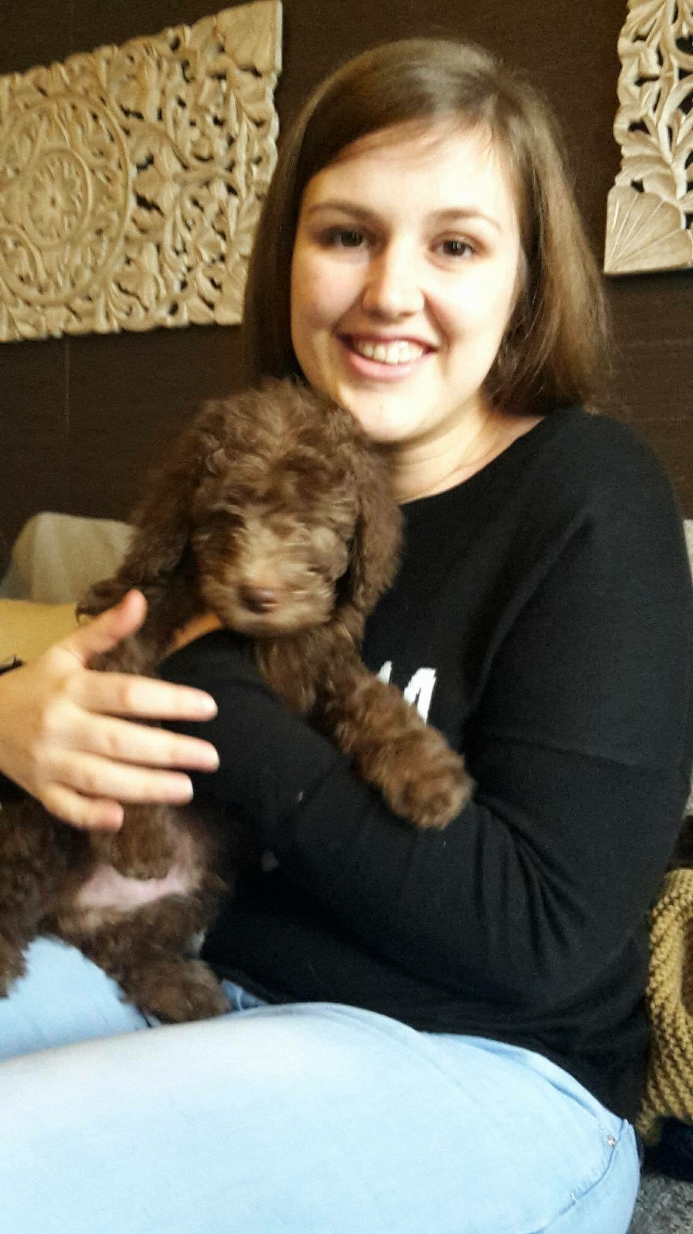



MEETINGS
DATA TAKING
WEDDINGS
CONFERENCES
RENOVATIONS
CHRISTMASSES
FAMILY
EXPANSION
PUBLICATION
TRACKER
SHIFTS

Slide 5

PARTICLES

Slide 6
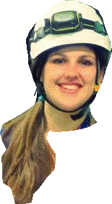
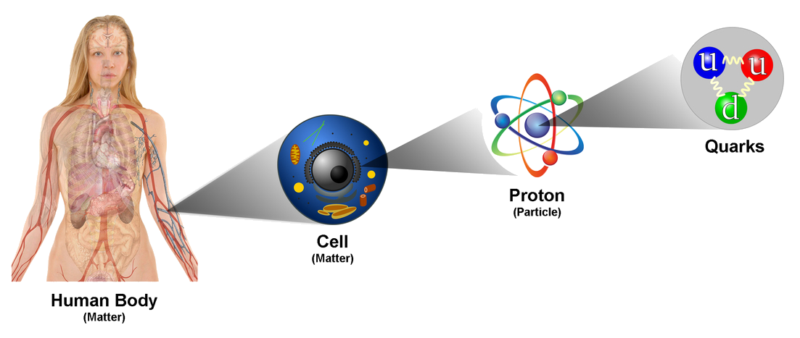
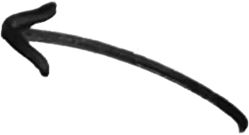
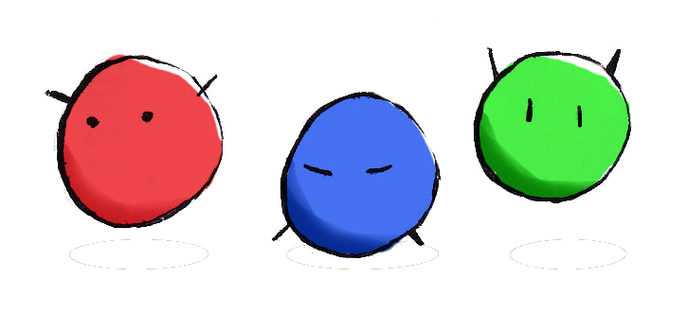
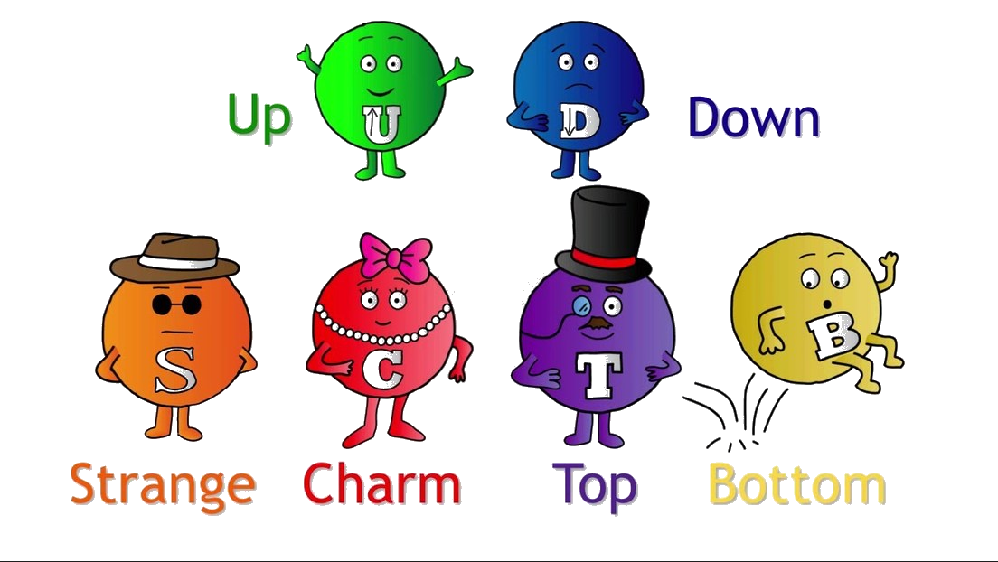

Protons consist of quarks
electrons
u
u
d
GEN 1
electron
What are the fundamental particles?
electron
neutrino

Slide 7





FERMIONS
GAUGE
BOSONS
GEN 1
GEN 2
GEN 3
QUARKS
gluon
Higgs
photon
LEPTONS
The Standard Model of
particle physics
electron
muon
tau
Z boson
electron
neutrino
muon
neutrino
tau
neutrino
W boson

Slide 8



My research
NC
NC
CC
NC = neutral current
gluon
Via exchange g / γ / Z
forbidden at tree level
Suppressed at higher order
photon
CC = charged current
Via exchange W boson
Described by CKM- and PMNS matrix
electron
muon
tau
CC
Z boson
electron
neutrino
muon
neutrino
tau
neutrino
W boson

Slide 9
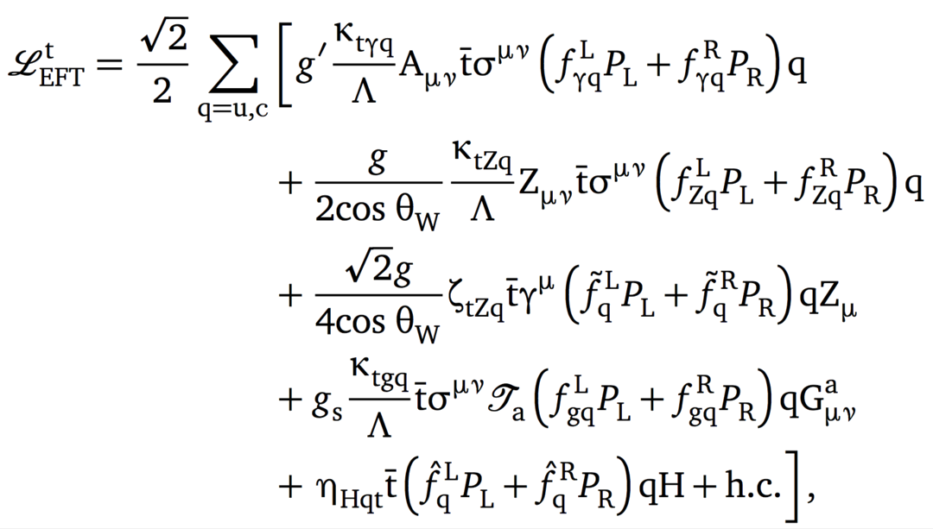
My research
I am looking at two “kinds” of flavour changing neutral current couplings
top – Z – up
top – Z – charm
INTERACTION
INTERACTION
Z boson
Z boson

Slide 10
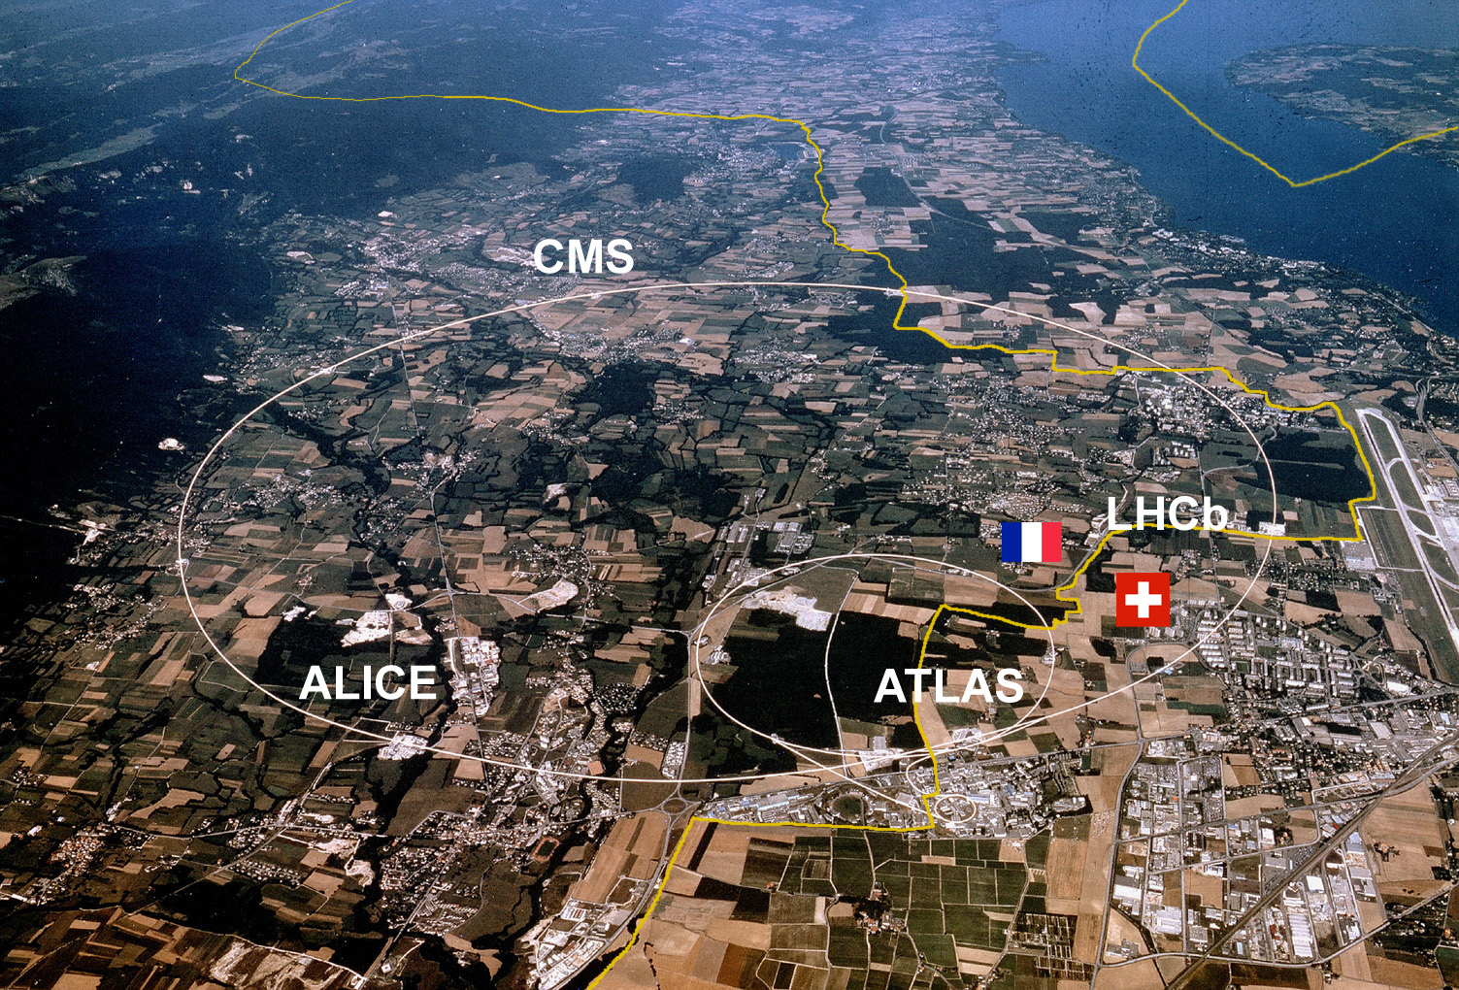
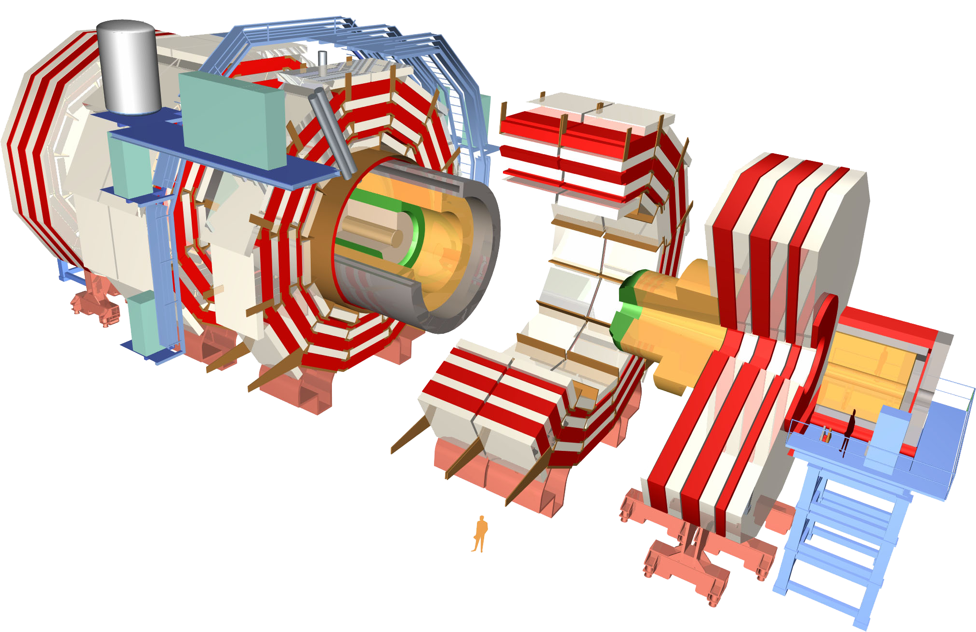
The Large Hadron Collider
Home to e.g. CMS and ATLAS.
Experiments that study proton collisions
Billions of protons travelling at 99.9999991% of the speed of light
More than 11000 tours of 27km per second!

Slide 11
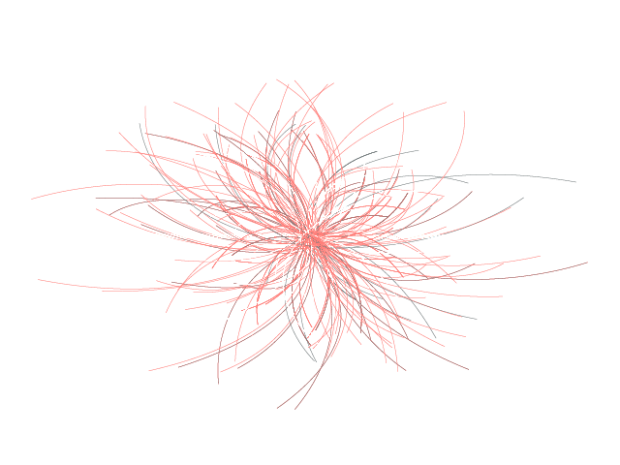
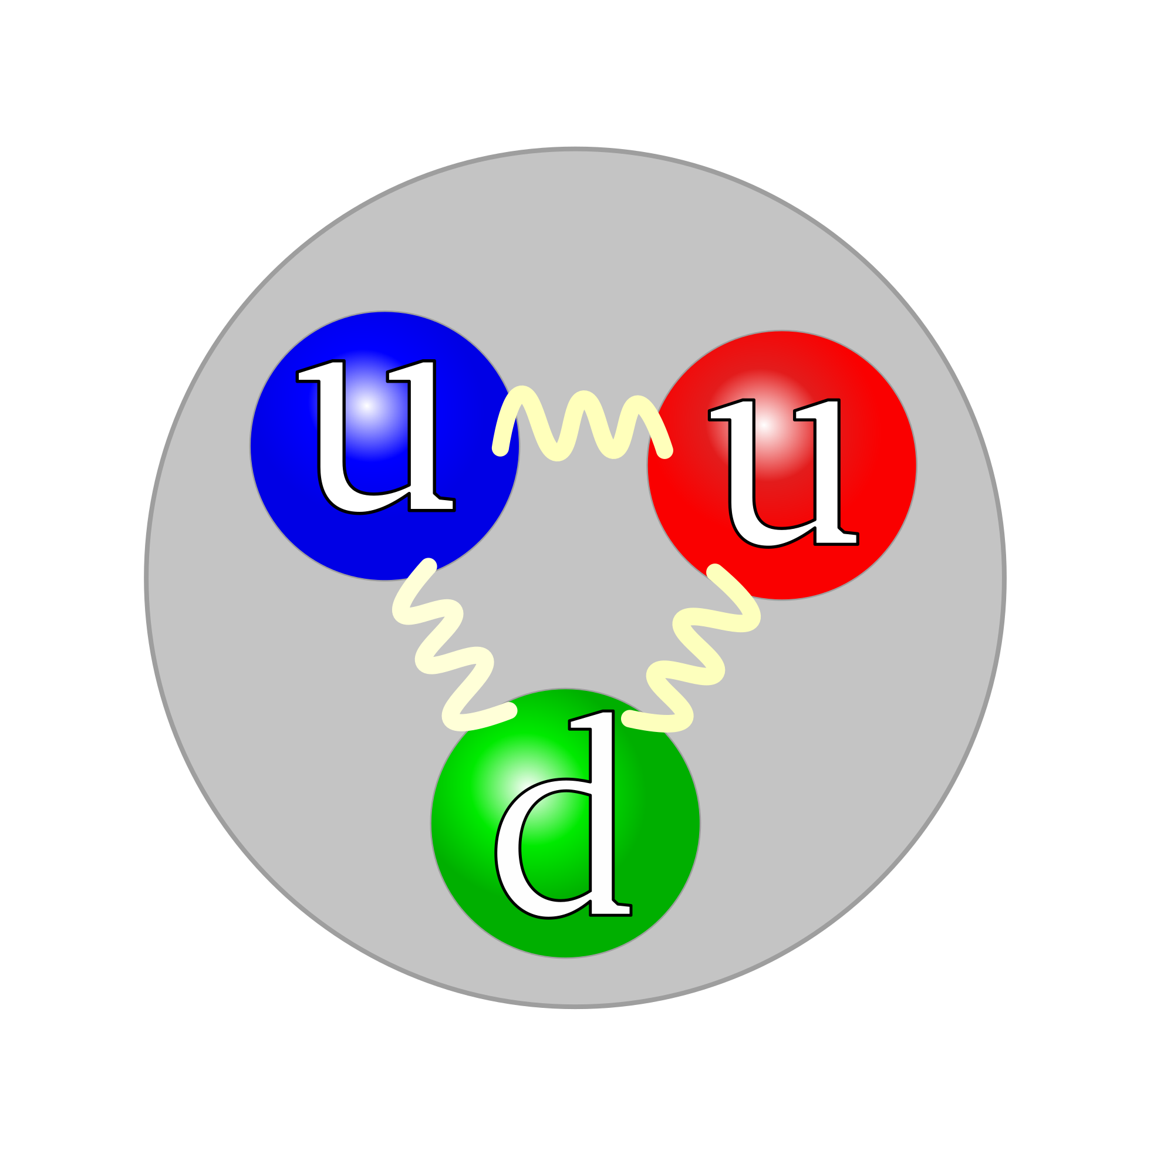
The LHC collides proton collisions at 7 TeV, 8 TeV, 13 TeV
E = mc²
Approx. nb. Of top quark pair events:
7 TeV: 868 000
8 TeV: 4 854 920
13 TeV: 29 294 400
u
u
d
7.5 TeV
7.5 TeV
u
u
13 TeV
LARGE HADRON COLLIDER
d
CMS detector

Slide 12
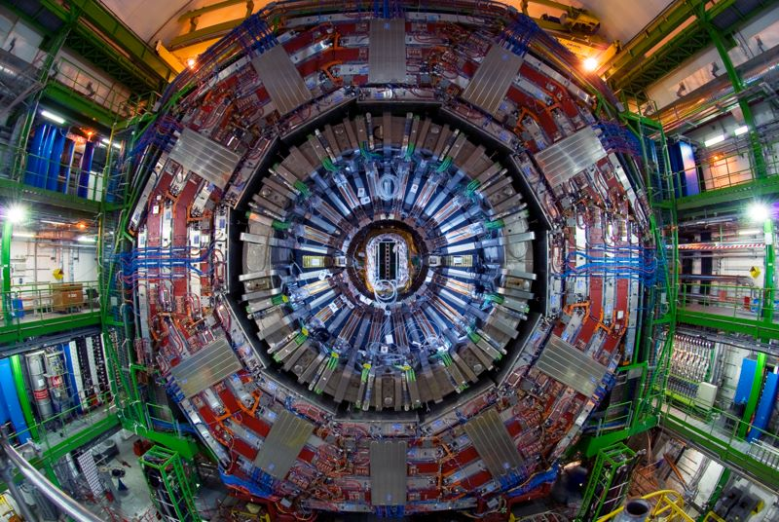
CMS detector

Slide 13
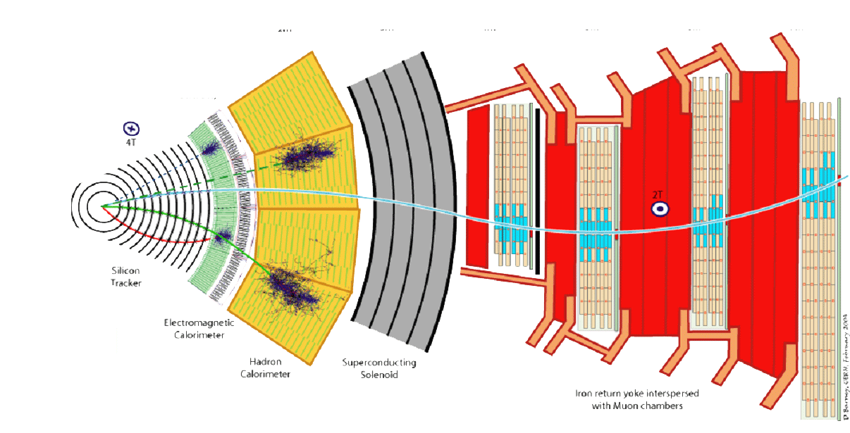
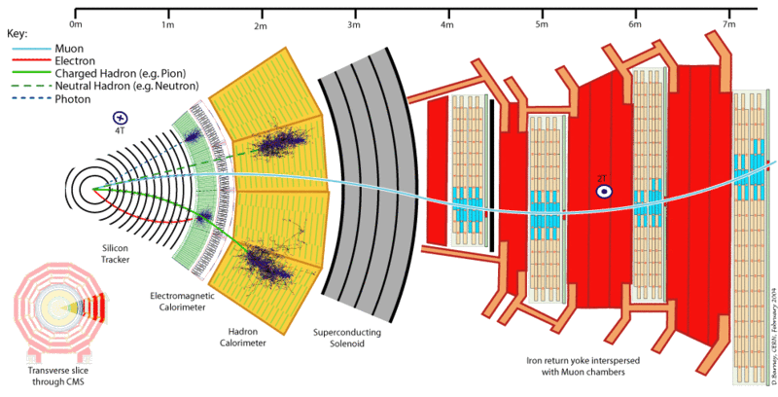
Tracker
ECAL
HCAL
Magnet
Muon
13

Slide 14
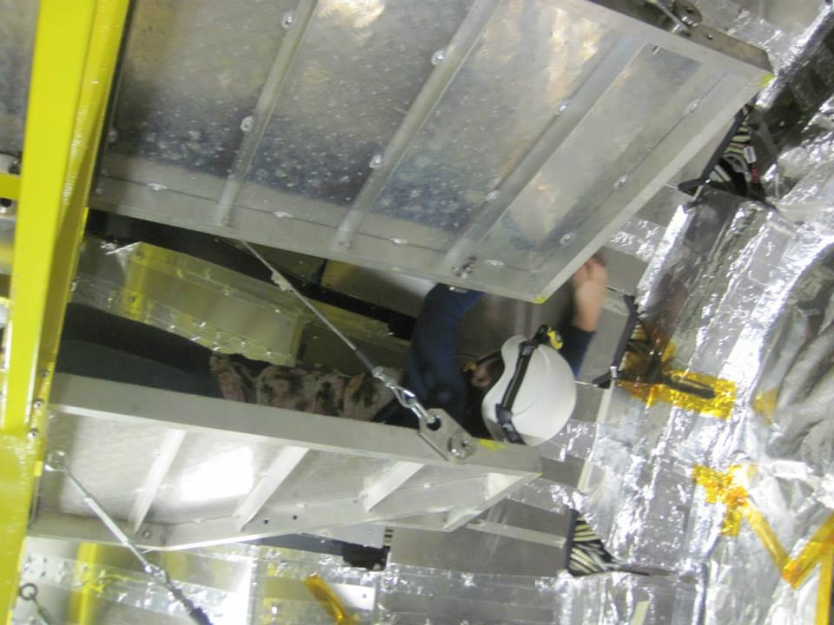
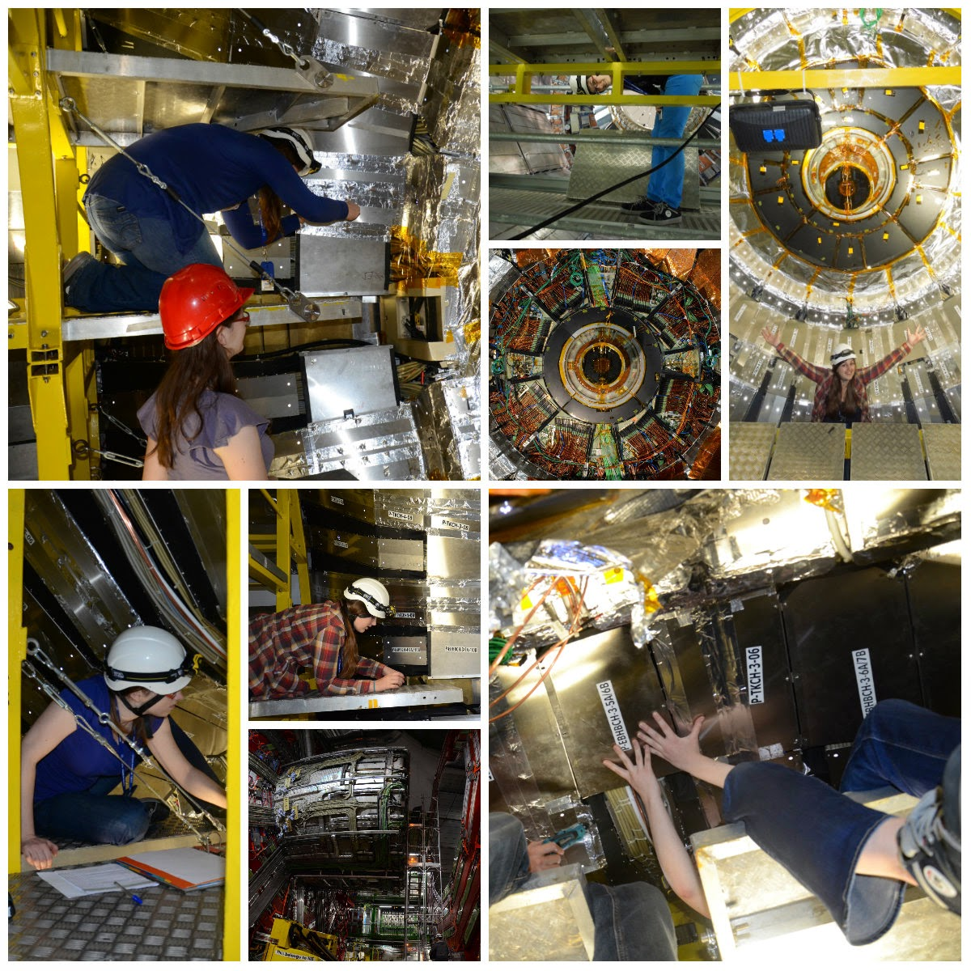
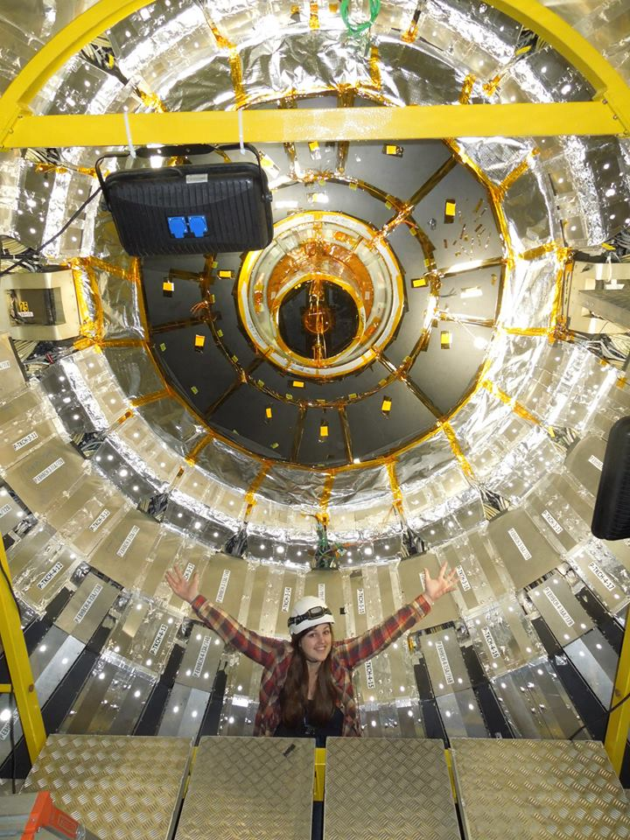
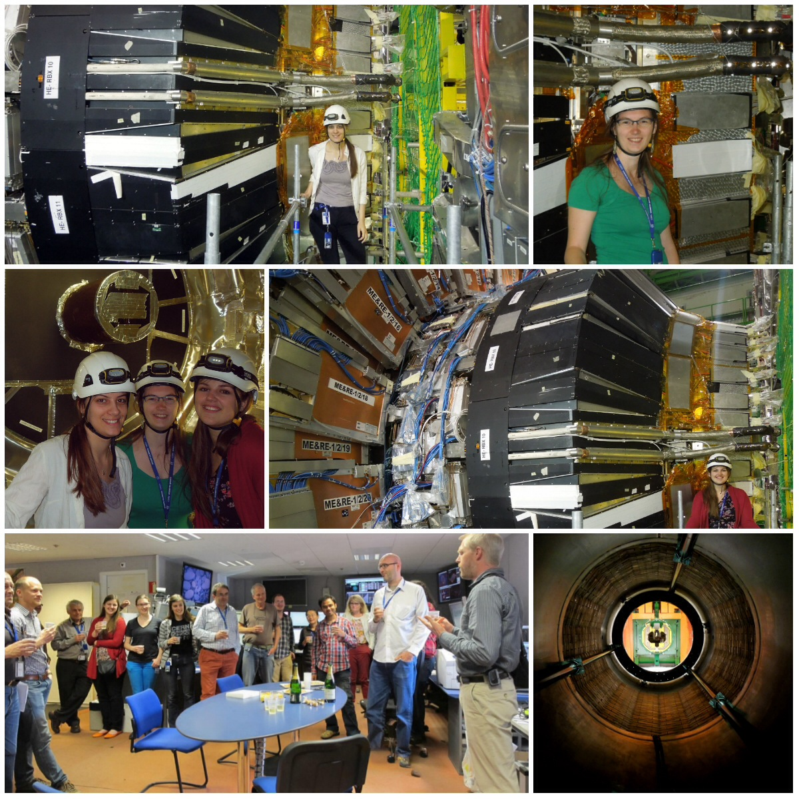
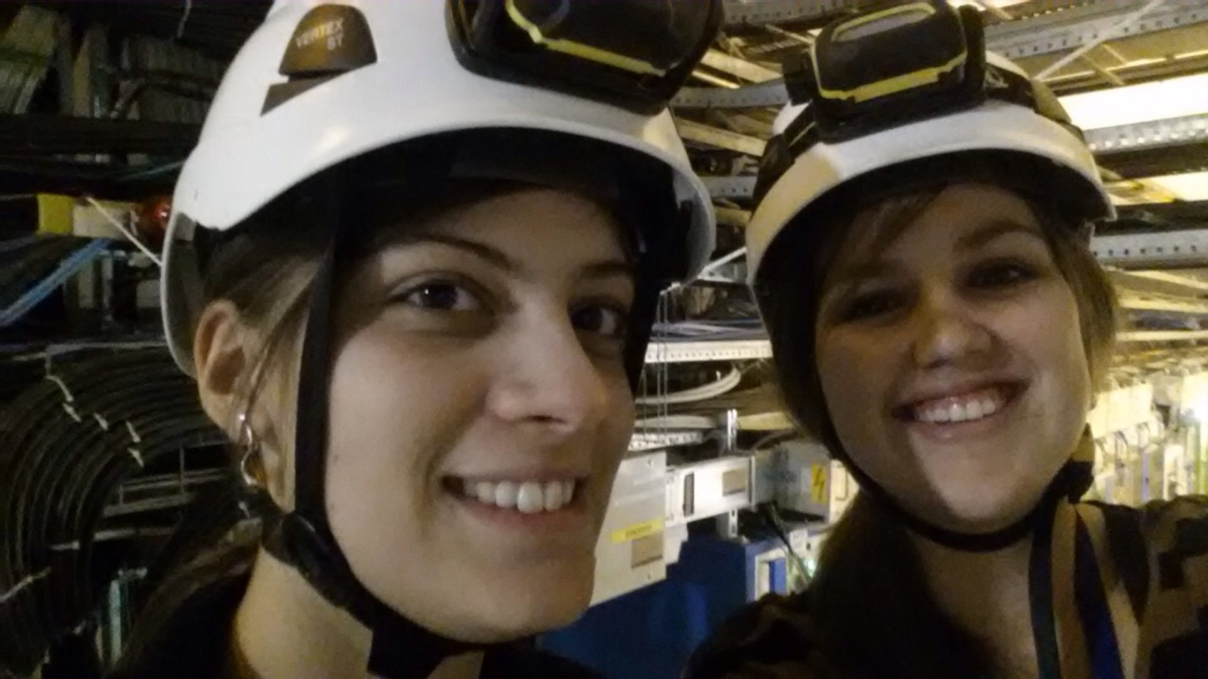

Slide 15
SKETCH OF
PROTON COLLISION IN CMS
15

Slide 16
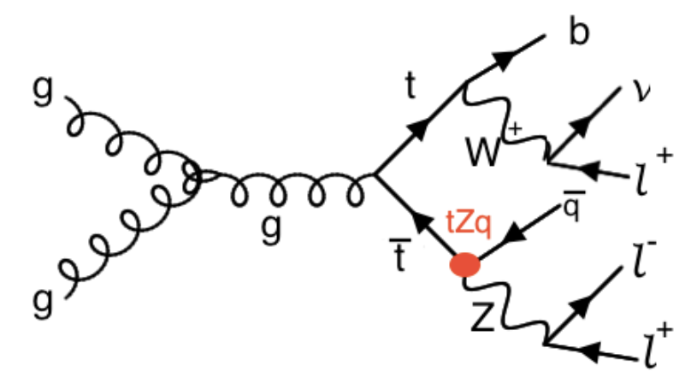
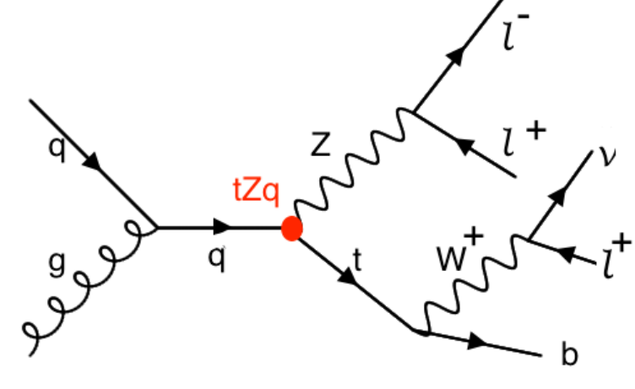
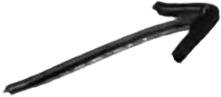
I am looking at two kinds of FCNC signal…
top quark pair decay
single top production
Notes:
Here you can see example feynman diagrams of the considerred signature. On the left is the top quark pair production through gluon fusion. One of the tops is decaying in a SM way to a W boson and a b quark and the other is decaying through the tZq vertex. I am only looking at leptonic decays. On the right you can see the tZ production where the top is decay in a SM way. As you can see, one has to reconstruct leptons, jets, b jets and neutrino’s.

Slide 17
I am looking at two kinds of FCNC signal… in the 3 lepton channel
top quark pair decay
single top production
Notes:
Here you can see example feynman diagrams of the considerred signature. On the left is the top quark pair production through gluon fusion. One of the tops is decaying in a SM way to a W boson and a b quark and the other is decaying through the tZq vertex. I am only looking at leptonic decays. On the right you can see the tZ production where the top is decay in a SM way. As you can see, one has to reconstruct leptons, jets, b jets and neutrino’s.

Slide 18
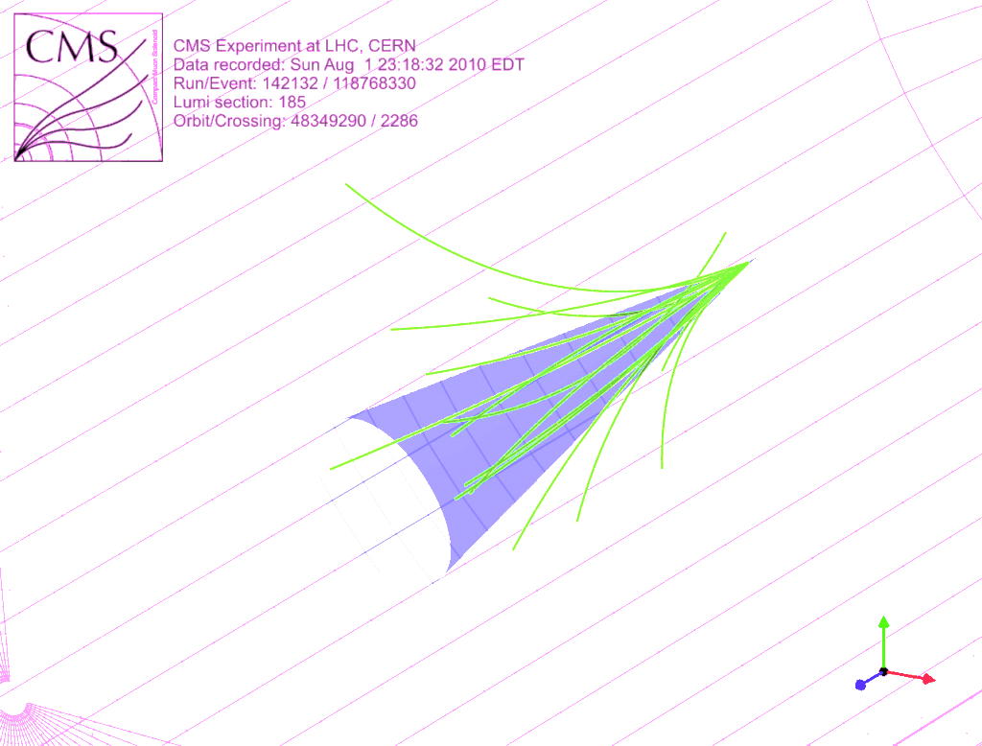
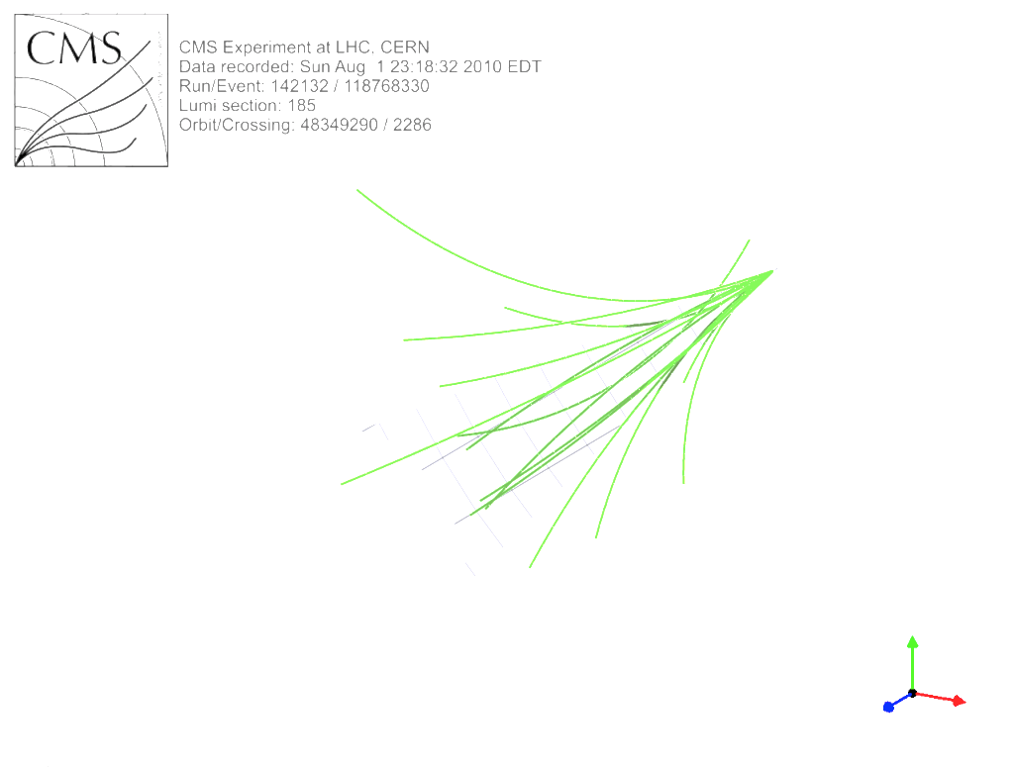
tZq FCNC
1 b jet
1 c/u jet
3 leptons
missing E_{T}
μ⁻
SKETCH OF
FCNC
SIGNATURE
Undetected: ν_{μ}
e⁺
Jets
e-
TOP QUARK PAIR DECAY

Slide 19
tZq FCNC
1 b jet
1 c/u jet
3 leptons
missing E_{T}
μ⁻
SKETCH OF
FCNC
SIGNATURE
Undetected: ν_{μ}
e⁺
SINGLE TOP QUARK PRODUCTION
e-
tZ FCNC
1 b jet
3 leptons
missing E_{T}

Slide 20
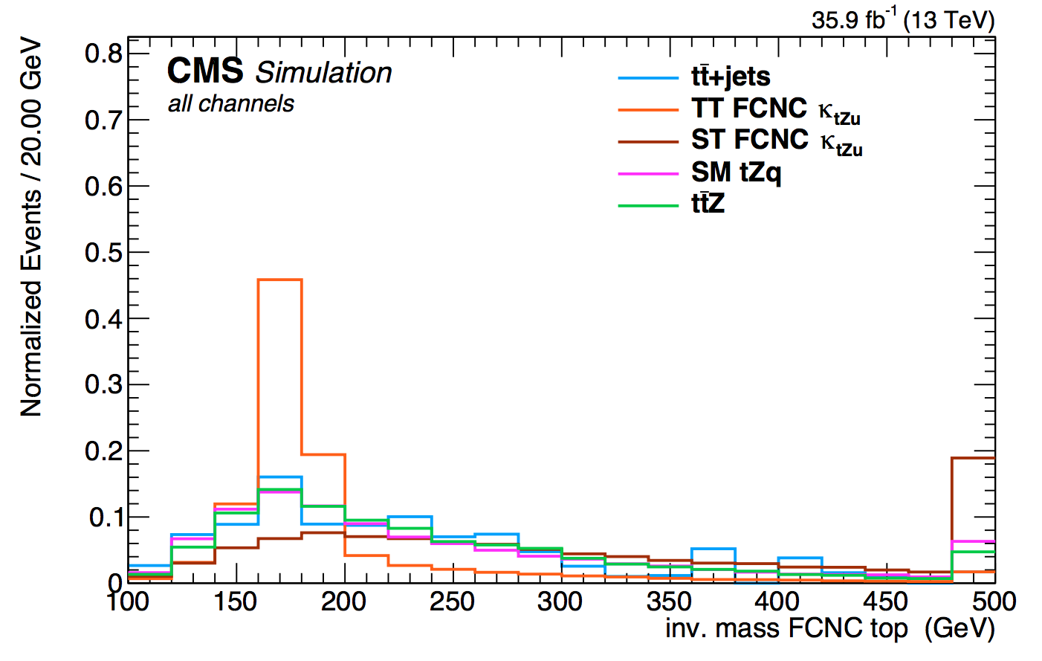
μ⁻
SKETCH OF
FCNC
SIGNATURE
Undetected: ν_{μ}
The invariant mass of these objects should give the mass of the top quark
e⁺
Jets
e-

Slide 21
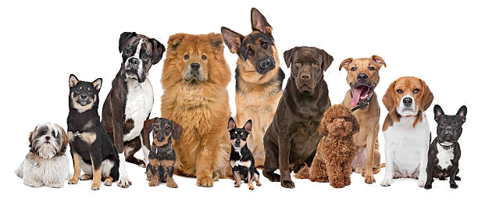

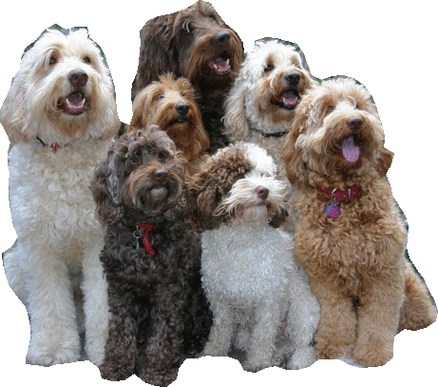


How to distinguish signal processes from background processes
Look at the properties!
Example: Is my dog there?
Obvious properties… size, colour,weight, species…
Also less obvious properties…
What is his DNA, does he know physics?, …

Slide 22
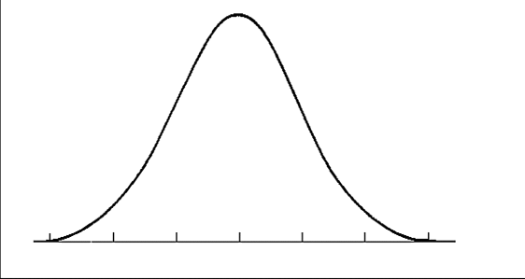
How to distinguish signal processes from background processes
Look at the properties!
Example: Is my dog there?
Obvious properties… size, colour,weight, species…
Also less obvious properties…
What is his DNA, does he know physics?, …
Simulate what you expect
Nb. of dogs
Signal
distribution
e.g. Labradoodles
1-10
10-20
20-30
weight
(kg)

Slide 23

How to distinguish signal processes from background processes
Look at the properties!
Example: Is my dog there?
Obvious properties… size, colour,weight, species…
Also less obvious properties…
What is his DNA, does he know physics?, …
Simulate what you expect
Nb. of dogs
Background
distribution
e.g. other do(u)gs
Signal
distribution
e.g. Labradoodles
1-10
10-20
20-30
weight
(kg)

Slide 24
How to distinguish signal processes from background processes
Look at the properties!
Example: Is my dog there?
Measurements
Nb. of dogs
Background
distribution
Signal
distribution
x
x
x
x
x
x
x
x
x
1-10
10-20
20-30
30-40
weight
(kg)

Slide 25
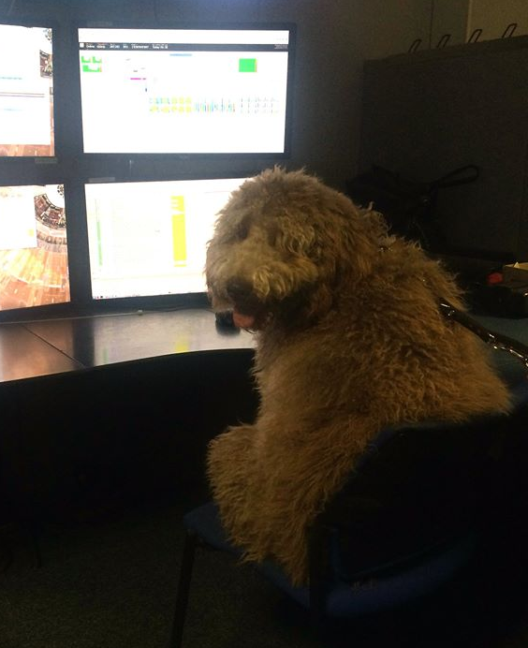

Multivariate analysis
Colour:
brown vs beige
LABRADOODLES
obedience
height: medium vs large
BDT
FIT TO
DATA
…
1 strong discriminating variable
BDT = boosted decision tree
→ 1D variable constructed from multiple variables
Various weak discriminating variables

Slide 26
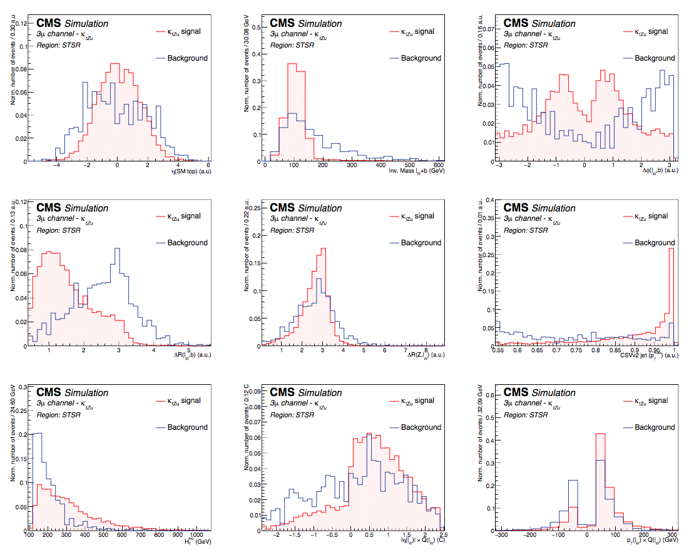
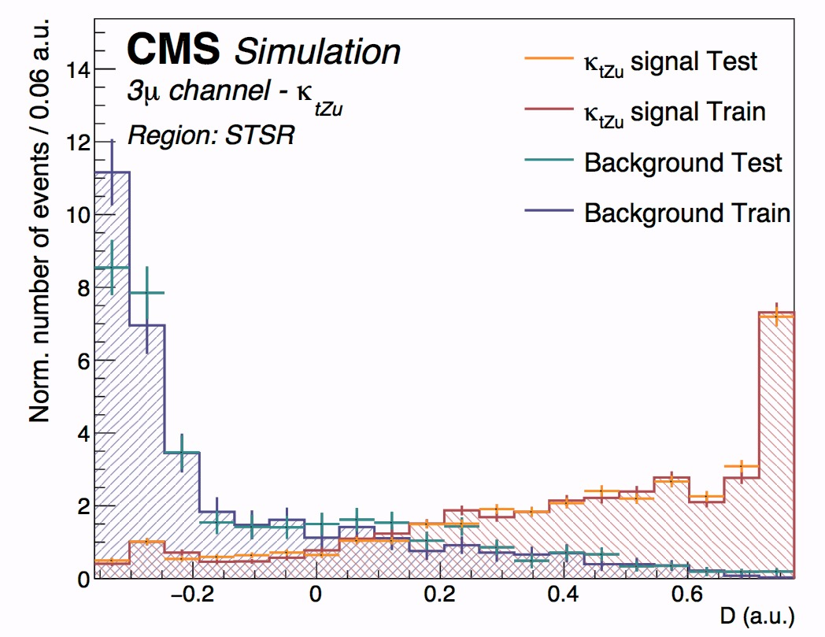
Multivariate analysis: physics case
BDT
FIT TO
DATA
My limit!
1 strong discriminating variable
Various weak discriminating variables

Slide 27
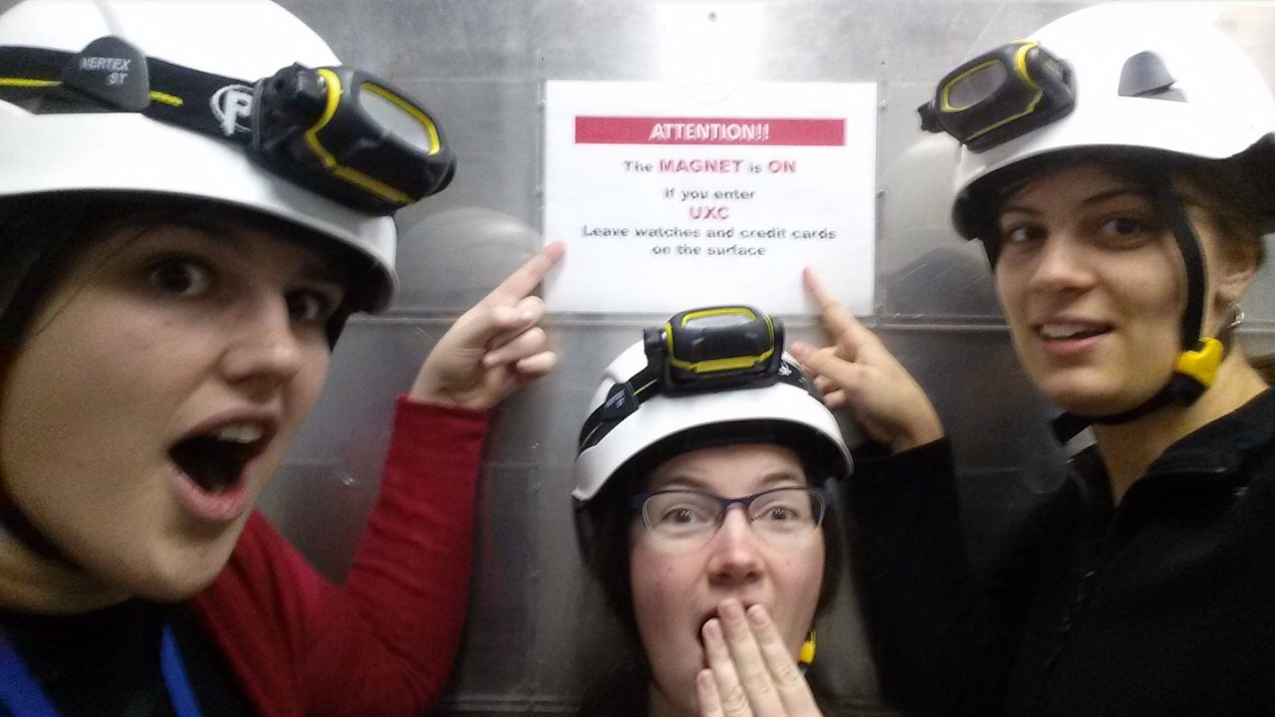
ATTENTION!!
NOVEL STRATEGY

Slide 28
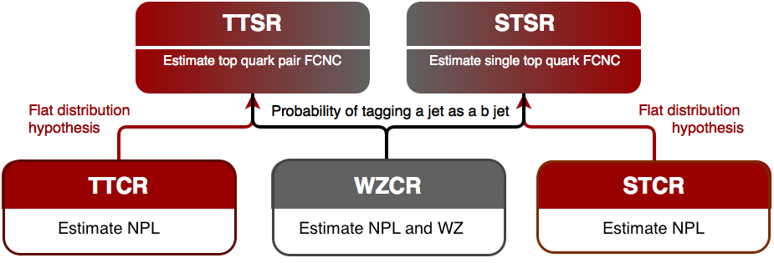
2 signal regions
top quark pair signal region
single top quark signal region
3 leptons
1 jet
1 b jet
3 leptons
1 b jet
Separate trainings:
4 three-lepton channels: eee – eeμ – μμe – μμμ
2 couplings: up and charm
Main backgrounds:
WZ+jets
ttZ
tZq
Not prompt-leptons (NPL)
Notes:
There are two signal regions created. One targetting the top quark pair production and one targetting the single top quark pair production. They differ by the number of jets. Since I am looking at electrons and muons, there will be four different lepton channels. Furthermore, there are two couplings under investigation: the top – up – Z coupling and the top – charm – Z coupling. In the next slides I will only show distributions for the up coupling in the three muon channel.

Slide 29
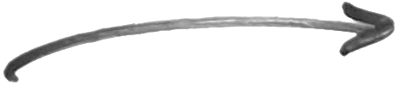
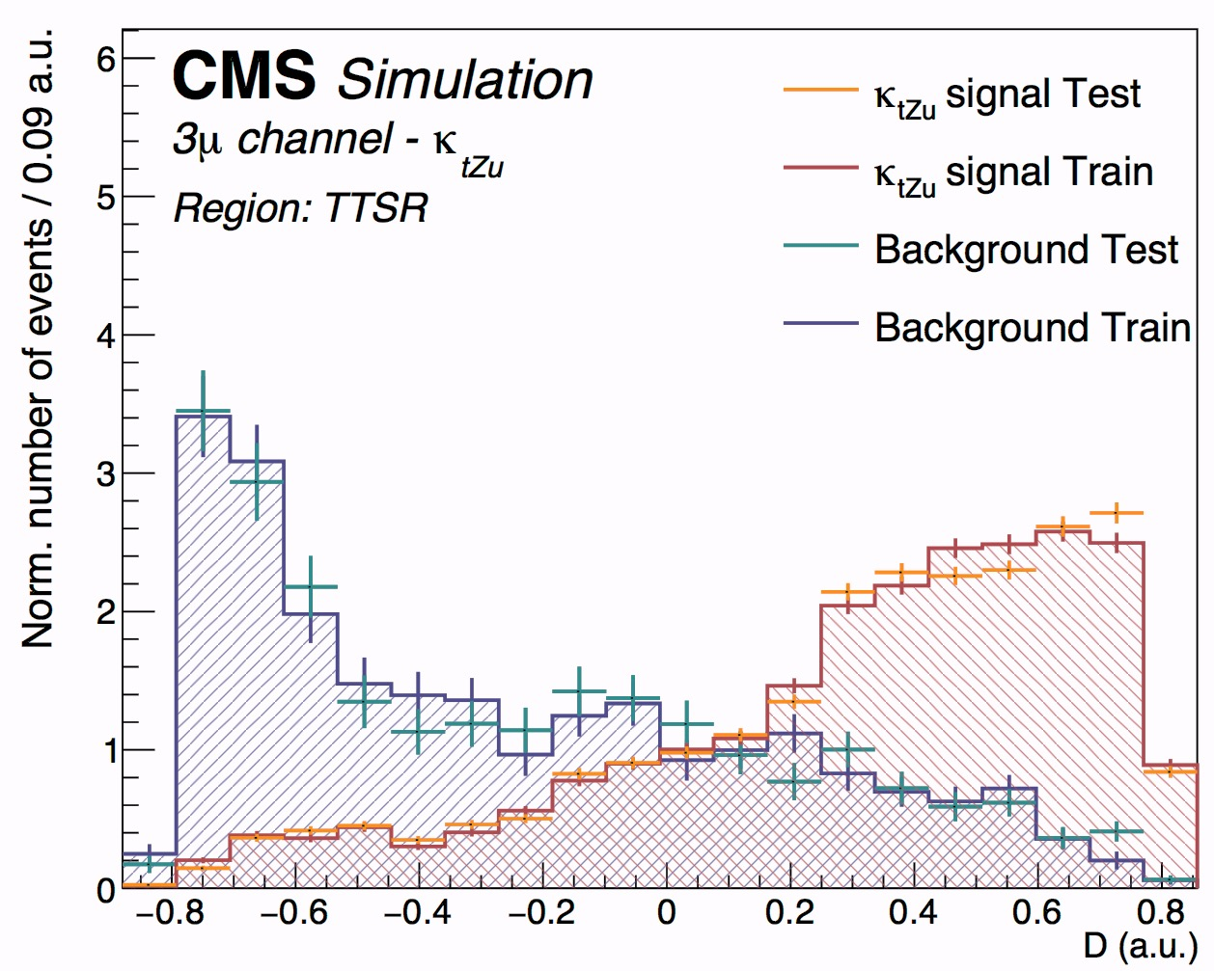
multivariate analysis
BDT
BDT
3 leptons
1 jet
1 b jet
3 leptons
1 b jet
Notes:
In each signal region, a multivariate discriminator is constructed top seperate signal from background proceses. The main background are WZ, ttZ, tZq and not prompt leptons. The not prompt lepton contribution will be estimated in a data driven way and are not included in the trainings. Here one can see the distribution for the top quark pair training in the three muon channel. The samples are split up in test and training samples and these are in agreement with eachother. Furthermore, one can see that signal and background are seperated. On the right you can see the distribution for the single top signal region. Where again the test and training samples agree and there is a clear seperation between signal and background like events.

Slide 30
Get a better handle on the main backgrounds!
BDT
BDT
3 leptons
1 jet
1 b jet
3 leptons
1 b jet
3 leptons
2 jets
No b jets
WZ
control region
Notes:
The next step is to define a control region that targets one of the main backgrounds WZ and the not prompt lepton background. This region is created to enhance the WZ process and is defined in a similar way as the signal regions but with a veto on events with b-tagged jets.

Slide 31
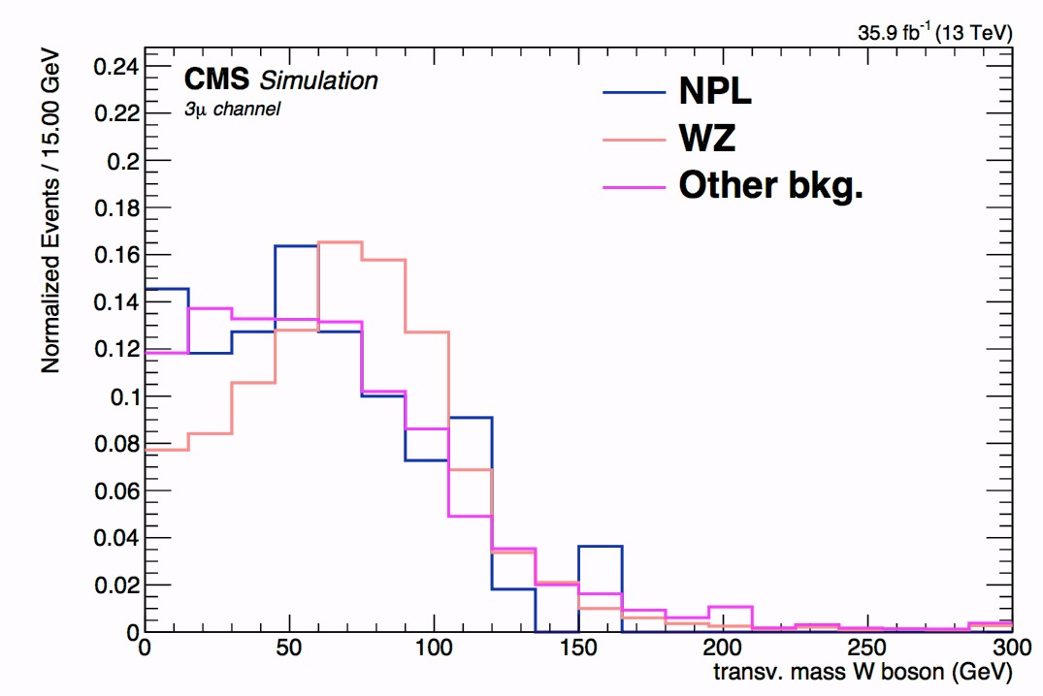
Get a better handle on the main backgrounds!
BDT
BDT
3 leptons
1 jet
1 b jet
3 leptons
1 b jet
3 leptons
2 jets
No b jets
Fit on m_{T}(W)
Notes:
In this region, the transverse mass of the W boson is fitted to data to get and estimate of the NPL and WZ rate and then through the probability of tagging a jet as b jet, this rate extrapolated to the signal regions. Here ion the plot, one can see this distribution for the three muon channel. Where the WZ process peaks at the W boson mass, while the NPL distribution peaks at lower values and drops to zero. Now this region will mainly contain not prompt lepton background cause by Drell Yann events. In order to also target the NPL contribution from top quark pair events, two additonal control regions are constructed.

Slide 32
Get a better handle on the main backgrounds!
BDT
BDT
Inside Z mass window
Inside Z mass window
Fit on m_{T}(W)
top quark pair control region
single top quark control region
Outside Z mass window
Outside Z mass window
Notes:
A top quark pair control region and single top quark pair control region are constructed by putting the same requirements as the corresponding signal regions, but to work outside the Z mass window.

Slide 33
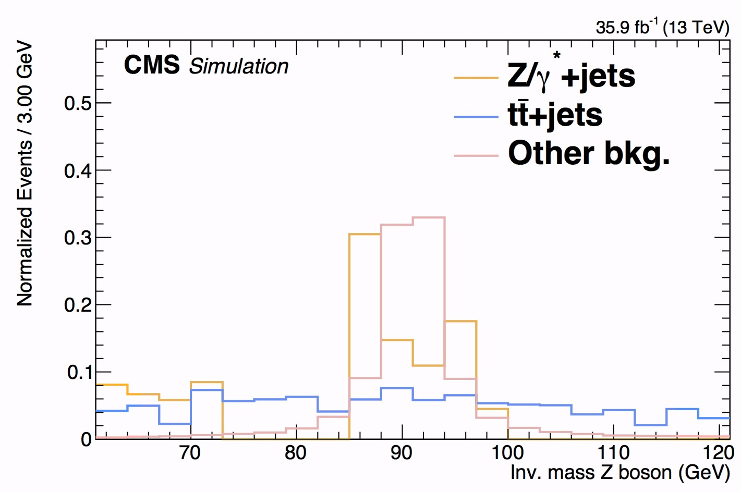
Get a better handle on the main backgrounds!
BDT
BDT
Inside Z mass window
Inside Z mass window
OUT
IN
OUT
count
Fit on m_{T}(W)
count
Outside Z mass window
Outside Z mass window
Notes:
Here you can see the for the top quark pair events, the Z boson mass distribution is flat. Therefore one can take the rate of the NPL background from outside the Z mass window and extrapolate its expected value to the signal region by merely multiplying it by the ratio of the mass windows.

Slide 34
Analysis strategy
BLINDED APPROACH
SIGNAL INJECTION TESTS
VALIDATED WITH MAXIMUM LIKELIHOOD FIT
VALIDATED WITH SIMULATION
Notes:
So in summary, there are two signal regions, each targetting an FCNC signal through the use of a BDT. Then three control regions are used to estimate the not prompt lepton contribution and WZ+jets contributions in the signal regions. This strategy has been set up using a blinded strategy and signal injection tests have been performed. Furthermore, a maxmimuml likelihood fit is done in the WZCR to see validate the fit to the the transcerse mass of the W boson. Also the extrapolation of the NPL backgrounds to the signal regions has been validated using their monte carlo predictions.

Slide 35
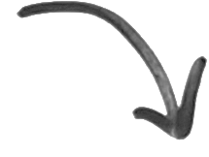
Add systematic uncertainties
e.g. normalisation: Luminosity,
shape: Jet energy scale
One analysis for tZc
One analysis for tZu
x 4 lepton channels
Do a global fit
→ Limits at 95% CL
Notes:
After these validations, and after adding the systematic uncertainties, a global fit is performed using all four three lepton channels and all regions for each coupling.

Slide 36
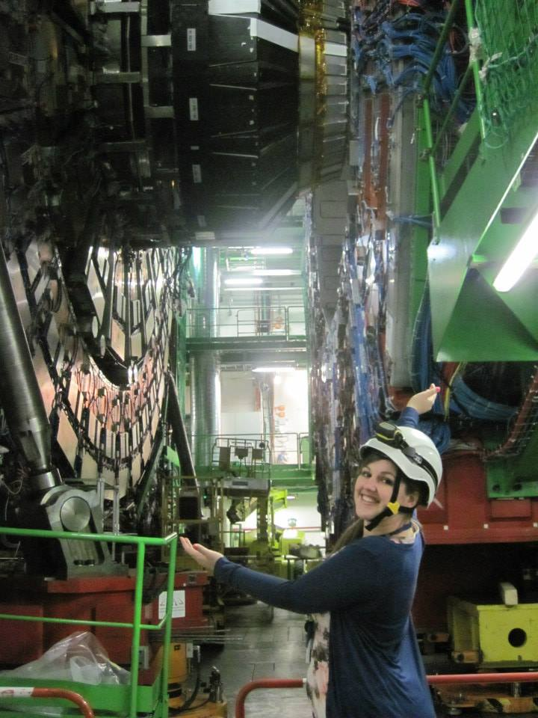
RESULTS

Slide 37
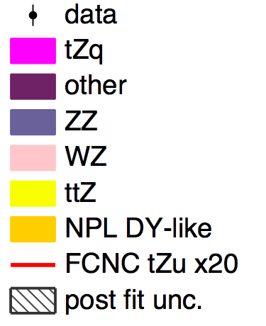
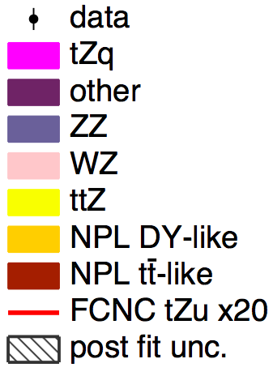
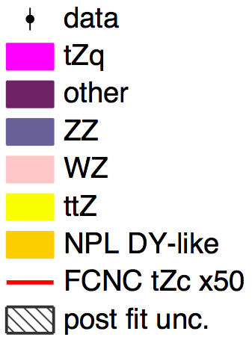
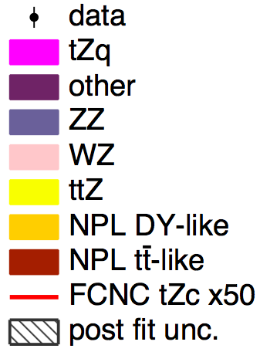
Post fit results
UP
COUPLING
WZCR
TTSR
STSR
CHARM
COUPLING
WZCR
TTSR
STSR

Slide 38

I will set limits on branching fractions
B
( → )
Branching fraction B =
# particles which decay by an individual decay mode
total number of particles which decay
FCNC?
single top quark and top quark pair
FCNC search @ 8 TeV
B(t → uZ ) < 0.022 %
B(t → cZ ) < 0.049 %

Slide 39

Results
B(t → Zu) < 0.024 %
(0.015 %)
B(t → Zc) < 0.045 %
(0.037 %)
More stringent than previous best limits of CMS!
Expected limits for tZu better than ATLAS!

Slide 40
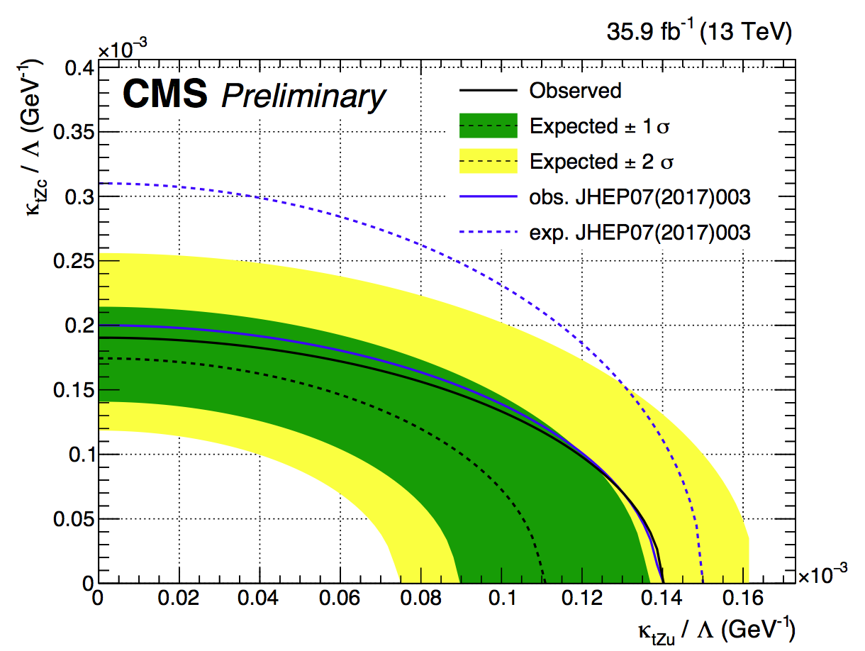
Resulting 2D limits on the couplings
Results

Slide 41

Results
B(t → Zc) < 0.045 % (0.037 %)
B(t → Zu) < 0.024% (0.015 %)
Looking at
the greater picture

Slide 42

Outlook
Extra control region for ttZ background, charm tagging, global EFT fit, ….

Slide 43
What have I been doing
Tracker shifts
Phenomenology study of all top FCNC couplings
Worked on top-Z FCNC analysis at 8 TeV
Spoken at several conferences
Convenor of the SM/FCNC tZq group that produced two publications
Paving the way for tZq FCNC with an EFT approach
Novel and improved strategy with better handle on NPL background
Top quark pair and single top FCNC studied together
Limit is better than the most stringent 8 TeV result
Analysis performed in the same timeframe as ATLAS
Expected limits comparable/better with most stringent limit from ATLAS

